Slide 1
Neural Substrates of Attention and Awareness
Dan Birman
Gardner Lab
Kalanit Lab Meeting – 2015-02-06
Notes:
Okay! I’m interested in attention/awareness, but these are often ill-defined. I’m going to use an example to get the ideas across.

Slide 2


Notes:
Show animation, then go back and repeat: asking to attend to background (21 total black dots move, 22 with the first)
Point here is that you have no AWARENESS of the changes in the first attempt, while you’re attending to the dots. But you need very little additional attention to notice them. No bottom-up attention = inattentional blindness

Slide 4
Notes:
Now it’s obvious

Slide 5
Attention as a Pre-Requisite to Awareness
Dual task designs “pull” attention to one task, causing inattentional blindness for other stimuli.
“we believe […] there is no conscious perception without attention” (Mack & Rock, 1998)
“The close relationship between attention and
consciousness has led many scholars to conflate these
processes“ (Koch & Tsuchiya, 2006)
Mack & Rock, 1998

Slide 6
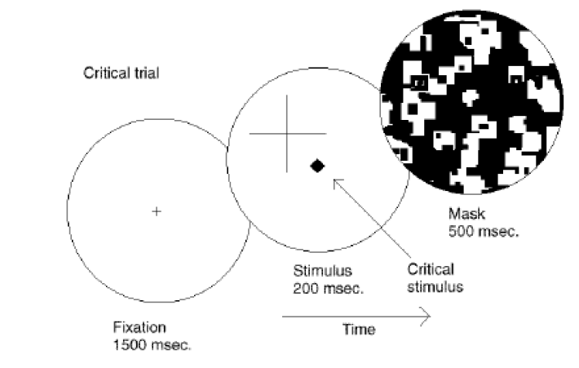
Attention as a Pre-Requisite to Awareness
Dual task designs “pull” attention to one task, causing inattentional blindness for other stimuli.
“we believe […] there is no conscious perception without attention” (Mack & Rock, 1998)
Mack & Rock, 1998
Notes:
There is one situation where attention (seems) to not be a pre-requisite for awareness

Slide 7
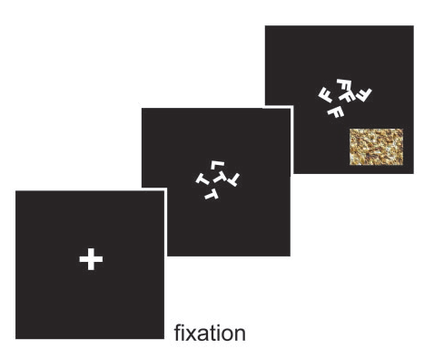
Gist Perception
“The close relationship between attention and
consciousness has led many scholars to conflate these processes“ (Koch & Tsuchiya, 2006)
Li et al., 2002
Reddy et al., 2004

Slide 8

Gist Perception
Li et al., 2002
Reddy et al., 2004

Slide 9
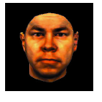
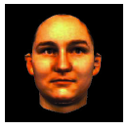
Gist Perception
Li et al., 2002
Reddy et al., 2004

Slide 10
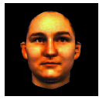
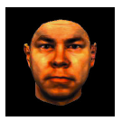
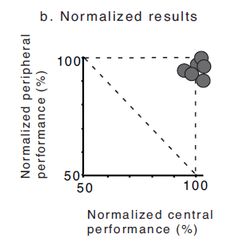
Gist Perception
Li et al., 2002
Reddy et al., 2004
Notes:
Note: dual task performance NORMALIZED by single task performance

Slide 11
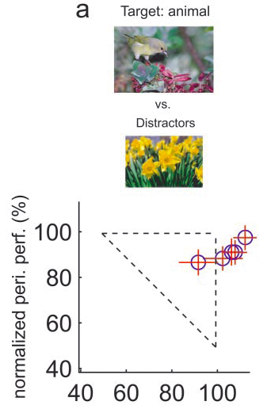
Gist Perception
Li et al., 2002
Reddy et al., 2004

Slide 12
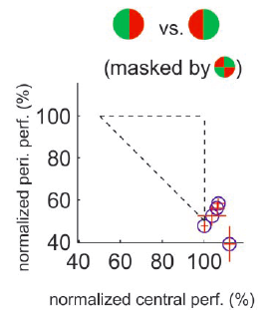
Gist Perception
F
L
F
F
F
F
Li et al., 2002
Reddy et al., 2004
Notes:
Note the whole story… what if the central task was not difficult enough? Or maybe it didn’t “interfere” with the other task?

Slide 13
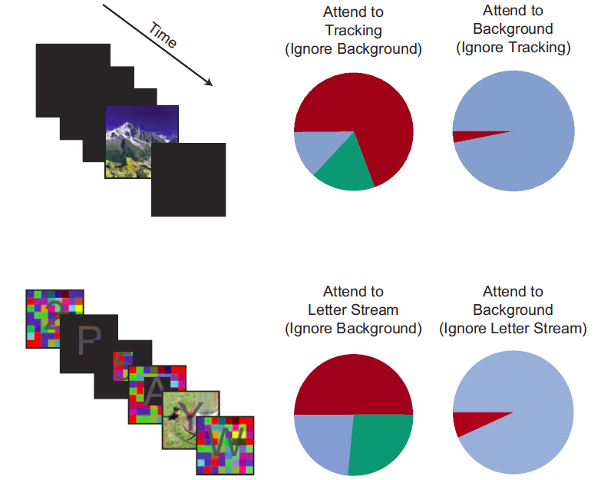
Gist Perception: Impossible Under Load?
Blind
Classified
Saw
Cohen et al., 2011
Notes:
Some tasks DO interfere enough to inhibit awareness. No awareness without attention. So is attention the precursor to awareness?

Slide 14
Takeaway: Attention/Awareness is a Mess
The current solution is to operationalize attention: defining attention in terms of it’s (measurable) effects. But this definition ends up capturing a number of different neural implementations which all “feel” similar.
An alternative solution is to define these concepts in terms of functional definitions.

Slide 15
Takeaway: Attention/Awareness is a Mess
The current solution is to operationalize attention: defining attention in terms of it’s (measurable) effects.
An alternative solution is to define these concepts in terms of functional definitions.
Stimulus Present

Slide 16
Takeaway: Attention/Awareness is a Mess
The current solution is to operationalize attention: defining attention in terms of it’s measurement.
An alternative solution is to define these concepts in terms of functional definitions.
Stimulus Present
Attending

Slide 17
Takeaway: Attention/Awareness is a Mess
The current solution is to operationalize attention: defining attention in terms of it’s measurement.
An alternative solution is to define these concepts in terms of functional definitions.
Stimulus Present
Attending
Visible - Invisible

Slide 18


http://www.globeimages.net/data/media/180/berlin_cathedral_front.jpg

Slide 19
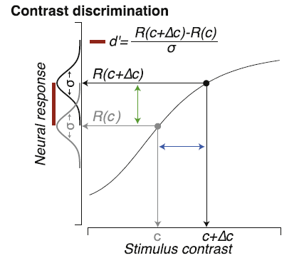
Identifying Neural Substrates
Pestilli et al., 2011

Slide 20
Identifying Neural Substrates
Pestilli et al., 2011
Notes:
Neural response is monotonic increasing according to some function R()

Slide 21
Identifying Neural Substrates
Pestilli et al., 2011

Slide 22
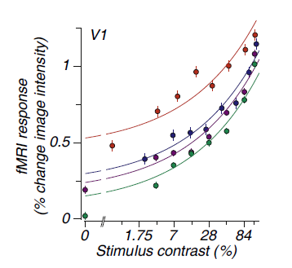
Identifying Neural Substrates
BOLD Magnitude
Pestilli et al., 2011

Slide 23
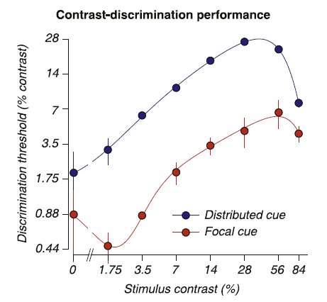
Identifying Neural Substrates
BOLD Magnitude
Pestilli et al., 2011

Slide 24
Identifying Neural Substrates
Behavioral Performance ←→ BOLD Magnitude
Pestilli et al., 2011

Slide 25
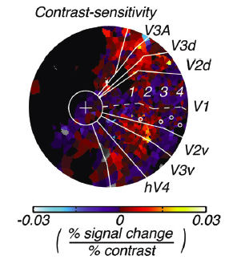
Feature Dependent Neural Substrates
Hara et al., 2014
Tjan et al., 2006

Slide 26
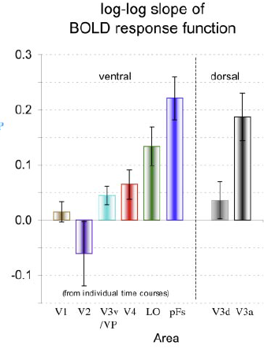
Feature Dependent Neural Substrates
to objects
in noise
Hara et al., 2014
Tjan et al., 2006

Slide 27
Conceptual Overview: Attention & Awareness
“Recent research has slowly corroded a belief that selective attention and consciousness are so tightly entangled that they cannot be individually examined.” (van Boxtel et al. 2010)
Instead of focusing on dissociating attention and awareness, we should be focused on understanding their neural substrates.
Attention: Local feature-specific modulation of neural activity
Awareness: A downstream process, dependent in an uncertain manner on attention.
Computational Modeling:
Notes:
First attempt: dual

Slide 28


Conceptual Overview: Task Design
Where are the representations for different properties of stimuli held in the brain?
What are the neural effects of pushing attention to a specific location or feature?
How can we measure awareness while manipulating attention?
Notes:
First attempt: dual

Slide 29
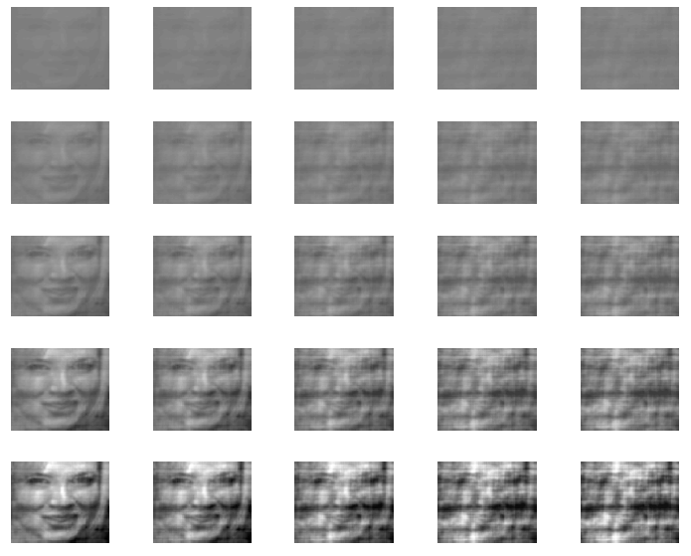
(1) Measuring Stimulus Properties
Contrast
Noise

Slide 30
(2) Selective vs. Spatial Attention
1 Block = 72 trials, ~6.4s per trial
Noise Block
Contrast Block
Feature Attention: Attend to either changes in noise or changes in contrast

Slide 31




(2) Selective vs. Spatial Attention
1 Block = 72 trials, ~6.4s per trial
Noise Block
Contrast Block
Fixation ITI
Cue
Stimulus
Response

Slide 32
(2) Selective vs. Spatial Attention
Focal Spatial Cue
Distributed Spatial Cue

Slide 33


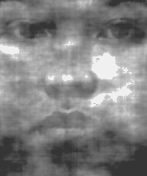

(3) Measuring Un-Attended Awareness

Slide 34


(3) Measuring Un-Attended Awareness

Slide 35
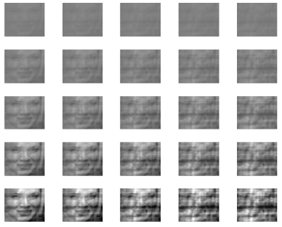
Conceptual Overview: Task Design
What the properties of stimuli represented in different brain areas?
What are the effects of pushing attention to a specific location or feature?
How can we measure awareness while manipulating attention?
Notes:
First attempt: dual

Slide 36




Overall Task Timing
Fixation ITI: 1s
Cue: 1s
Stimulus 1: .6s
Peripheral Response: .75s
Stimulus 2: .6s
Per Response: .75s
Response
Main Response: 1.2s

Slide 37

Notes:
High (dual) vs. Low (single) task conditions. Expectation: During dual task contrast/gender will have better performance than noise/gender, because noise attention is more feature-based than contrast which is more spatial.

Slide 38
Conceptual Overview: Expectations
We have one major, behavioral, expectation: Feature attention, for example to level of noise, will interact with awareness of gender.
Our initial hypothesis was that attending to noise, a face feature, would reduce performance on the gender task.
100%
Single Task
Dual Task
Peripheral Task
Contrast
Noise
100%
Main Task
Notes:
First attempt: dual

Slide 39
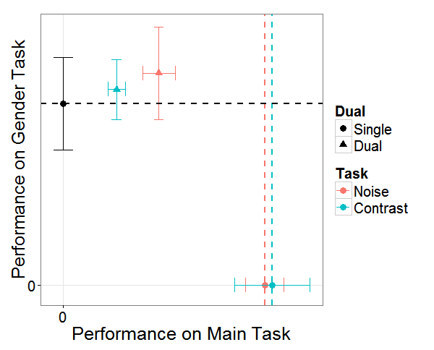
Attention * Awareness
Notes:
Gender same across all categories

Slide 40
Attention * Awareness
There was an interaction between feature attention and awareness—but in an unexpected direction.
Is awareness of gender really a matter of “awareness”? Evidence that reading, arithmetic, priming, etc…, can be done “blind” to some extent.
Strong bottom-up attentional effects. Attention is “drawn” towards the peripheral faces.
Timing is an issue: Relative response positions cause one task to be prioritized.
Dual tasks are hard. Long training required.
Naccache et al. 2002; Sklar et al. 2012

Slide 41





(1) Specific Measures of Awareness

Slide 42
(1/2) Change Blindness: Less Bottom-Up Salience

Slide 43

(3) Timing is an issue…
Instead of a dual task, a single task with similar features.
ITI + Cue
Stimulus (change/no change)
Variable ISI
Response

Slide 44
Future Task Design
What the properties of stimuli represented in different brain areas?
What are the effects of pushing attention to a specific location or feature?
How can we measure awareness while manipulating attention?
Notes:
First attempt: dual

Slide 45





Future Task Design
Is awareness of gender really a matter of “awareness”? / Strong bottom-up attentional effects.
Timing is an issue: Relative response positions cause one task to be prioritized.
Dual tasks are hard. Long training required.

Slide 46



Gardner Lab @ Stanford University
Justin Gardner
Steeve Laquitaine
Thanks for your attention and awareness!

Slide 47
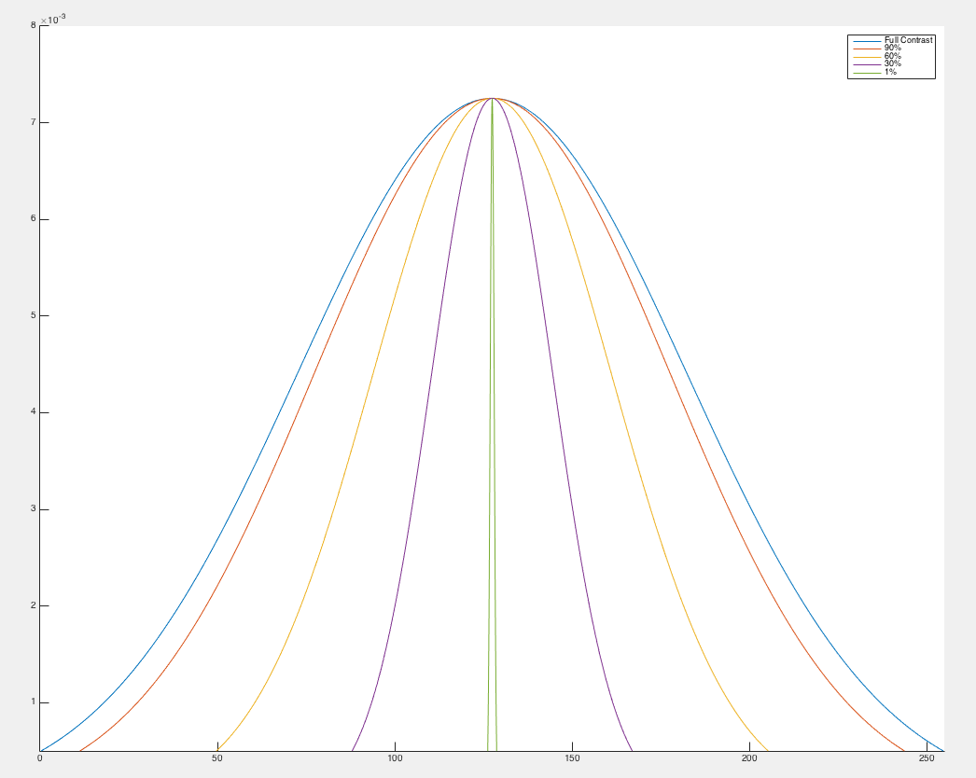
Manipulating Contrast

Slide 48
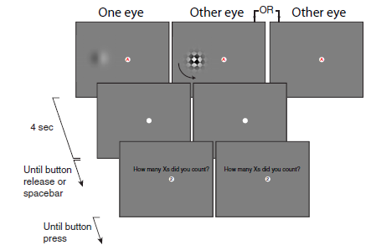
Attempts to Dis-Entangle Attention/Awareness
Dual Task Designs where attention is crossed with awareness. How does a dependent measure, e.g. afterimage length, depend on these factors?
van Boxtel et al., 2010
Notes:
Maybe attention is a pre-cursor to awareness. How might we show that? One idea is to dissociate attention and awareness.
Note: awareness manipulated with a mask or no mask, attention manipulated using secondary task

Slide 49
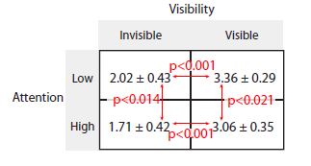
Attempts to Dis-Entangle Attention/Awareness
Afterimage Length (s)
van Boxtel et al., 2010
Notes:
Note that there is no bottom-up confound for visibility, since the expected effect is in the wrong direction
Other problems: do we really understand how binocular suppression works? Does it act at the right “stage” of processing?
Ultimately: we shouldn’t be talking about all kinds of attention and awareness equally, we need to be more specific to solve this question

Slide 50
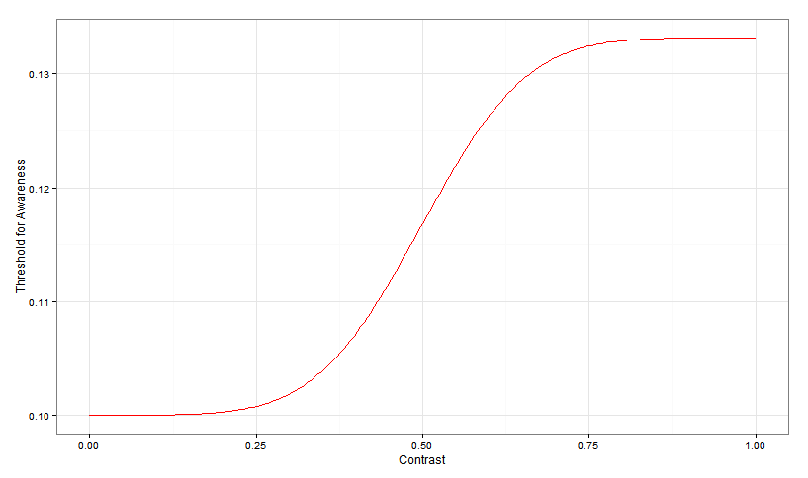
Expectations
Ped C

Slide 51
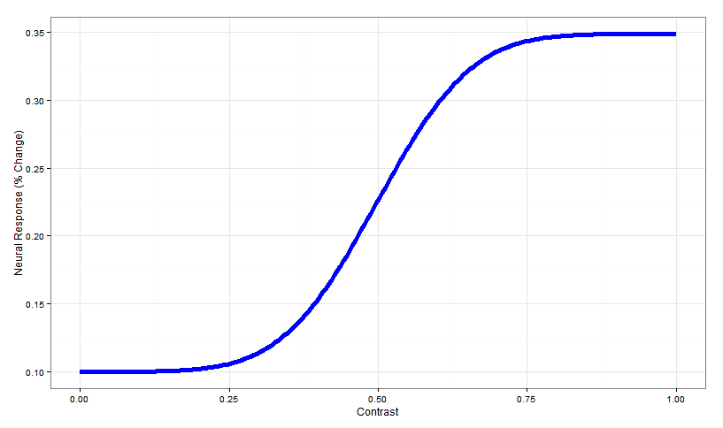
Expectations
Ped C

Slide 52
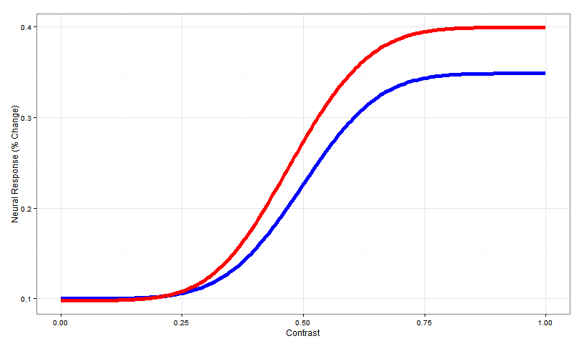
Expectations
Change in slope
due to attention
Ped C

Slide 53
Expectations
Can a (plausible) model of awareness, as a function of neural activity, capture the behavioral results in dual tasks?
Or do we need additional steps to explain how awareness can occur in the absence of “attention” (e.g. spatial attention) in some circumstances and not in others?
Change in slope
due to attention
Ped C

